Slide 1
Design of experiment
Design of experiment by definition, is an arrangement of conditions for collection and analysis of data in a manner that aims to combine relevance to the research purpose with economy in procedure.
It is a conceptual structure within which a research is conducted. It is a blueprint for collection, measurement and analysis of data.

Slide 2
DESIGN OF EXPERIMENTS
The goal of any experimental activity is to get the maximum realistic information about a system.
It is not always true that higher number of measurements will give maximum realistic information. Larger the number of measurements, huge will be the total error that enters into the measurement equation. Larger number of measurements lead to more costly experimentation.
It is important to obtain maximum realistic information with the minimum number of well designed experiments. An experimental program recognizes the major “factors” that affect the outcome of the experiment.

Slide 3
The factors may be identified by looking at all the quantities that may affect the outcome of the experiment.
The most important among these may be identified using a few exploratory experiments or
from past experience or based on some underlying theory or hypothesis.
The next thing one has to do is to choose the number of levels for each of the factors.
The data will be gathered for these values of the factors by performing the experiments by maintaining the levels at these values.

Slide 4
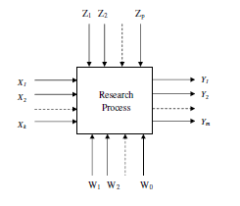
Uncontrolled inputs
Input variables
Or controlled variable
Output variable or response
Disturbances

Slide 5
Quality
No precision
Precision but
no validity
Precision & validity
Random error
Systematic error (bias)
Notes:
7

Slide 6
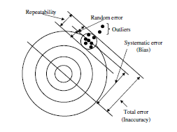
Errors

Slide 7
Principles of experimental design
Principle of replication:
Replication is not the same as repeated measurements of the same item. Both repeat and replicate measurements involve multiple observations taken at the same levels of experimental factors. However, repeat measurements are collected during a single experimental session, while replicate measurements are gathered across different experimental sessions. Replication in statistics evaluates the consistency of experiment results across different trials to ensure external validity, while repetition measures precision and internal consistency within the same or similar experiments. Replicates Example: Testing a new drug's effect on blood pressure in separate groups on different days.
Repeats Example: Measuring blood pressure multiple times in one group during a single session.

Slide 8
Principle of Randomization:
Randomization refers to the random order in which the runs of the experiment are to be performed. The method protects against an unknown bias distorting the results of the experiment.
Principle of Blocking:
Variability (known) due to extraneous factors such as known source variable can be measured and eliminated from experimental error

Slide 9
Research Design | Type of Research
 | Exploratory of formulative | Descriptive/Diagonistic
Overall Design | Flexible Design | Rigid design
Sampling Design Statistical Design Observational Design Operational Design | Non probability sampling design No preplanned design for a analysis Unstructured instruments for collection of data No fixed decision about procedure | Probability sampling design Preplanned design for analysis Structured instruments Advanced decision about procedure

Slide 10
Experimental design techniques
Informal experimental design
(i) Before-and-after without control design
(ii) After-only with control design
(iii) Before-and-after with control design
(b) Formal experimental design
(i) Completely randomized design
(ii) Randomized block design
(iii) Latin-square design
(iv) Factorial design
(V) ………

Slide 11
Informal experimental design
Case (i)
Phenomenon Before treatment
(x)
Treatment Introduced
Phenomenon
After treatment (Y)
Treatment Effect (Y-X)
Case (ii)
Phenomenon Before treatment
(x)
No Treatment Introduced
Phenomenon
After
(Y)
Effect (Y-X)
Case (iii)
Phenomenon Before treatment
(x) at time T1
Treatment Introduced
Phenomenon
After treatment (Y) at time T2
Phenomenon without treatment
(A) at time T1
No Treatment Introduced
Phenomenon
After T2
(Z)
Treatment Effect (Y-X)-(z-A)

Slide 12
(1) Completely randomized Design
Used to study of effects of one primary variable without considering the effect of nuisance factor.
(A factor of an experiment is a controlled independent variable; a variable whose levels are set by the experimenter ; Nuisance factor : A factor that probably has an effect on the response but is not a factor of interest. Nuisance factors are usually uncontrolled and is reflected as noise).
Three numbers k, L and n are used, where k is the number of factors, L is the number of levels and n is the number of replications, the number of data size is kLn.
For example, if 3 levels of the primary factor are considered, and it is desired to run each level twice, then the possible run sequences are 6!. Due to the replication, the number of unique sequence of run is

Slide 13
A typical example of a completely randomized design is the following:
k = 1 factor (X₁)
L = 4 levels of that single factor (called "1", "2", "3", and "4")
n = 3 replications per level
N = 4 levels × 3 replications per level = 12 runs
Randomized sequence of trials
The randomized sequence of trials might look like: X₁: {3, 1, 4, 2, 2, 1, 3, 4, 1, 2, 4, 3}
In this example there are 12!/(3! 3! 3! 3!) = 369,600 ways to run the experiment, all equally likely to be picked by a randomization procedure

Slide 14
(2) Randomized complete block Design
Randomized complete block designs, however, differ from completely randomized designs. In RCBD, the experimental units are grouped into blocks according to known or suspected variations. RCBD is useful when the effect of one particular factor (in medical terms, the treatment factor) on the response variable is more relevant. The primary factor takes all possible values during a batch of experiments, and the nuisance factors are kept constant.
As a result, several factors cannot be controlled, but on average, their influence on response becomes negligible due to randomization. In RCBD, blocks represent factors with restrictions and cannot be randomized.

Slide 15
An experiment is conducted, with k numbers of controllable factors, denoted by, X₁; X₂ ........X_{k}, where one of them, X_{k}, is of primary interest.
The number of levels of each factor are L₁, L _{2.} ..........L_{k}.
If n (=1) number of replications are conducted for each experiment, the total number of experiments needed is given by N = n(L₁ L₂........ L_{k}).
One may consider a case where, k = 2, L₁ = 4; L₂ = 4, the nuisance factor is X₁, and the primary factor is X₂. Evidently, N = 16. The four levels of X₁ are A; B ;C, and D and that of X₂ are α, β, γ, δ,. The matrix of experiments is shown

Slide 16
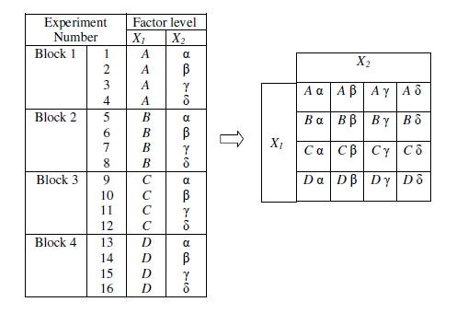
k = 2, L₁ = 4, ( A, B, C, D) ; L₂ = 4 (α, β, γ, δ) and total number of experiments needed is L₁ L₂
Nuisance
Primary factor

Slide 17
Latin square experiment
With the increase in the number of factors, the data size grows rapidly in Randomized Complete Block design (RCBD) experiments. The Latin square experimental design follows almost the same procedure as the RCBD. However, it's primary objective is to reduce the number of tests required. Therefore, instead of following the design of an RCBD, a single experiment in each block is conducted. The Latin square design is usually applicable for any k > 3.
Let us assume that X₁ and X₂ is the nuisance factors and X₃ is the primary factor. Therefore k = 3, The levels are taken as, L₁ = L₂ = L₃ = L. Hence, the size of the experiment is N = L² in contrast to the sample size of RCBD, where all levels are multiplied

Slide 18
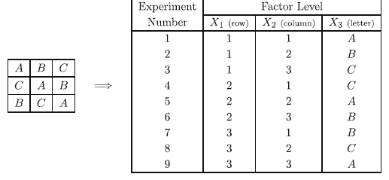
To represent the experiments, the two nuisance factors X₁ and X₂ are divided into a tabular grid with L rows and L columns. A capital Latin letter is put in each cell starting from the first letters of the alphabet. Each row and each column receive a letter only once.
Since controllable factor k = 3,
Primary factor
Nuisance factors

Slide 19
Full factorial design
A full factorial design of experiments consists of the following:
Vary one factor at a time
Perform experiments for all levels of all factors
Hence perform a large number of experiments that are needed!
All interactions are captured.
Consider a simple design for the following case:
Let the number of factors = k
Let the number of levels for the i^{th} factor = n_{i}
The total number of experiments (N) that need to be performed is

Slide 20
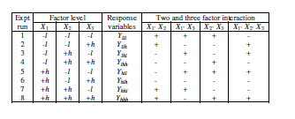
Full factorial is probably the most common and intuitive strategy of experimental design. In the most simple form, the two-levels full factorial, there are k factors and L = 2 levels per factor. The data are given by every possible combination of the factors values. Therefore, the size is N = 2^{k} . The two levels are called high (“h”) and low (“l”). Starting from any sample within the full factorial scheme, the samples in which the factors are changed one at a time are still part of the sample space.

Slide 21
Example
In a microstrip amplier design, three elements, W (the width of the microstrip lines), a resistor (R), and a Capacitor (C) are changed to observe their effects on the gain of the amplifier.
Since three elements are chosen for a full factorial experiment, the number of experiments needed is 2³ = 8.
We assign –l and +h values to each of the elements. For example, if the Resistor's nominal value is represented by 0, then –l represents --5% variation from its nominal value, and +h represents a +5% variation from its nominal value. If the resistor's nominal value is 20 ohms, the –l is 19 ohms, and the +h represents 21 ohms. Similarly for W, –l corresponds to 9.5 μm and 0 corresponds to nominal value of 10 μm, and +h corresponds to 10.5 μm.

Slide 22
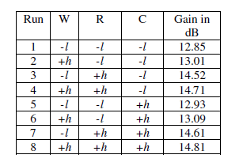
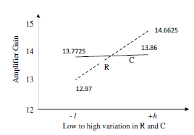
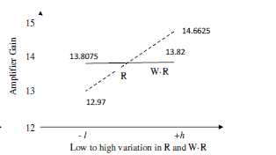
Calculate the average gain
Av. Gain for -l
Av. Gain for +l
Construct a linear equation to represent the experiment results:
Gain=13.8 + .09W + .85R + .044C + .0088WR + …. Etc.

Slide 23
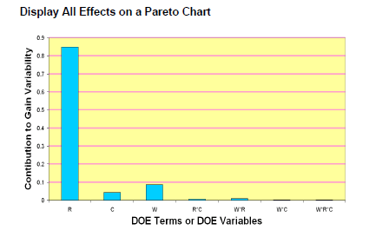
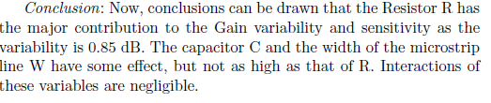
Pareto chart shows the relative importance

Slide 24

GOOD LABORATORY PRACTICE

Slide 25
GLP is a regulation for laboratory practice, originated in US in 1978 and then slowly accepted worldwide.
Definition: GLP embodies a set of principles that provides a framework within which laboratory studies are planned, performed, monitored, reported and archived.
GLP is a formal regulation that was created by the FDA (United states food and drug administration) in 1978.
In 1981 an organization named OECD (organization for economic co-operation and development ) produced GLP principles that are international standard.

Slide 26
Why was GLP created?
Examples of some of poor lab practices found were:
Equipment not been calibrated to standard form , therefore giving wrong measurements.
Incorrect/inaccurate accounts of the actual lab study
Inadequate test systems
OBJECTIVES OF GLP
GLP makes sure that the data submitted are a true reflection of the results that are obtained during the study.
GLP also makes sure that data is traceable.
Promotes international acceptance of tests.

Slide 27
FAMOUS EXAMPLE
Industrial Bio Test lab USA ran tests for big companies such as Procter and Gamble.
It was discovered that mice that they had used to test cosmetics such as lotion and deodorants had developed cancer and died.
Industrial Bio Test lab threw the dead mice and covered results deeming the products good for human consumption.
Those involved in production, distribution and sales for the lab eventually served jail time.

Slide 28
MISSION OF GLP
Test systems
Archiving of records and materials.
Apparatus, material and reagent facilities.
Quality assurance programs.
Performance of the study.
Reporting of study results.
Standard operating procedures (SOP)
Personnel and test facility organization

Slide 29
Standard Operating Procedures (SOP)
Written procedures for a laboratories program.
They define how to carry out protocol-specified activities.
Most often written in a chronological listing of action steps.
They are written to explain how the procedures are suppose to work
Procedure for routine inspection, cleaning, maintenance, testing and calibration.
Actions to be taken in response to equipment failure.
Keeping records, reporting, storage, mixing, and retrieval of data

Slide 30
Statistical Procedures for Data Evaluation
Statistical procedures are not simply chosen from a text book
Practitioners in a particular field may adopt certain standards which are deemed acceptable within that field.
Regulatory agencies often describe acceptable statistical procedures.

Slide 31
Reagent/ Materials Certification
to assure that reagents used are specified in the standard operating procedure.
Purchasing and testing should be handled by a quality assurance program.
Reagents and solutions shall be labeled
Deteriorated or outdated reagents and solutions shall not be used
Include Date opened
Stored under ambient temperature
Expiry date

Slide 32
Analyst Certification
Some acceptable proof of satisfactory training and/or competence with specific laboratory procedures must be established for each analyst.
Qualification can come from education, experience or additional trainings, but it should be documented
Sufficient people
Requirements of certification may vary

Slide 33
Documentation and Maintenance of Records
Maintenance of all records provide documentation which may be required in the event of legal challenges due to repercussions of decisions based on the original analytical results.
General guidelines followed in regulated laboratories is to maintain records for at least five years.
Length of time over which laboratory records should be maintained will vary with the situation

Slide 34
GLP Certification
Normally done by an external agency
Evaluation is concerned with issues such as
Adequate space
Ventilation
Storage
Hygiene

Slide 35
Now, 2 minutes noodle MAGGI issue and court case has raised several critical issues of GLP

